Slide 1
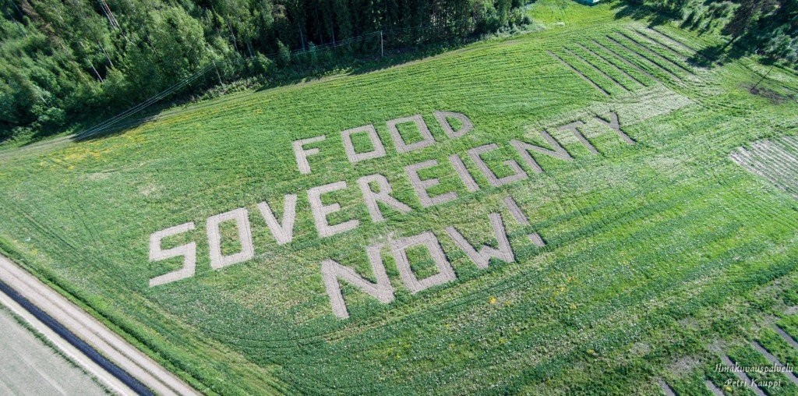
Ruby van der Wekken
Siemenpuu foundation
Oma Maa ruokaosuuskunta
Commons.fi

Slide 2
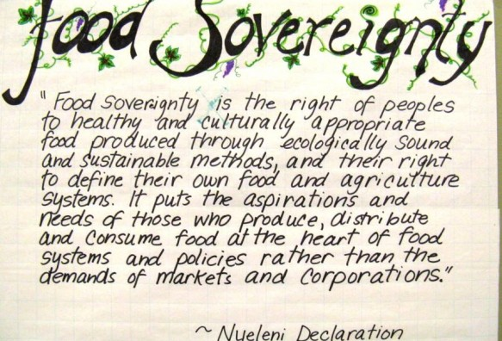
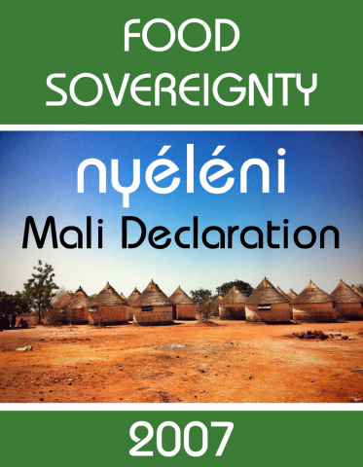

Food souvereignty : the right of all
People to democratically decide
how food is produced, distributed
and consumed.

Slide 3
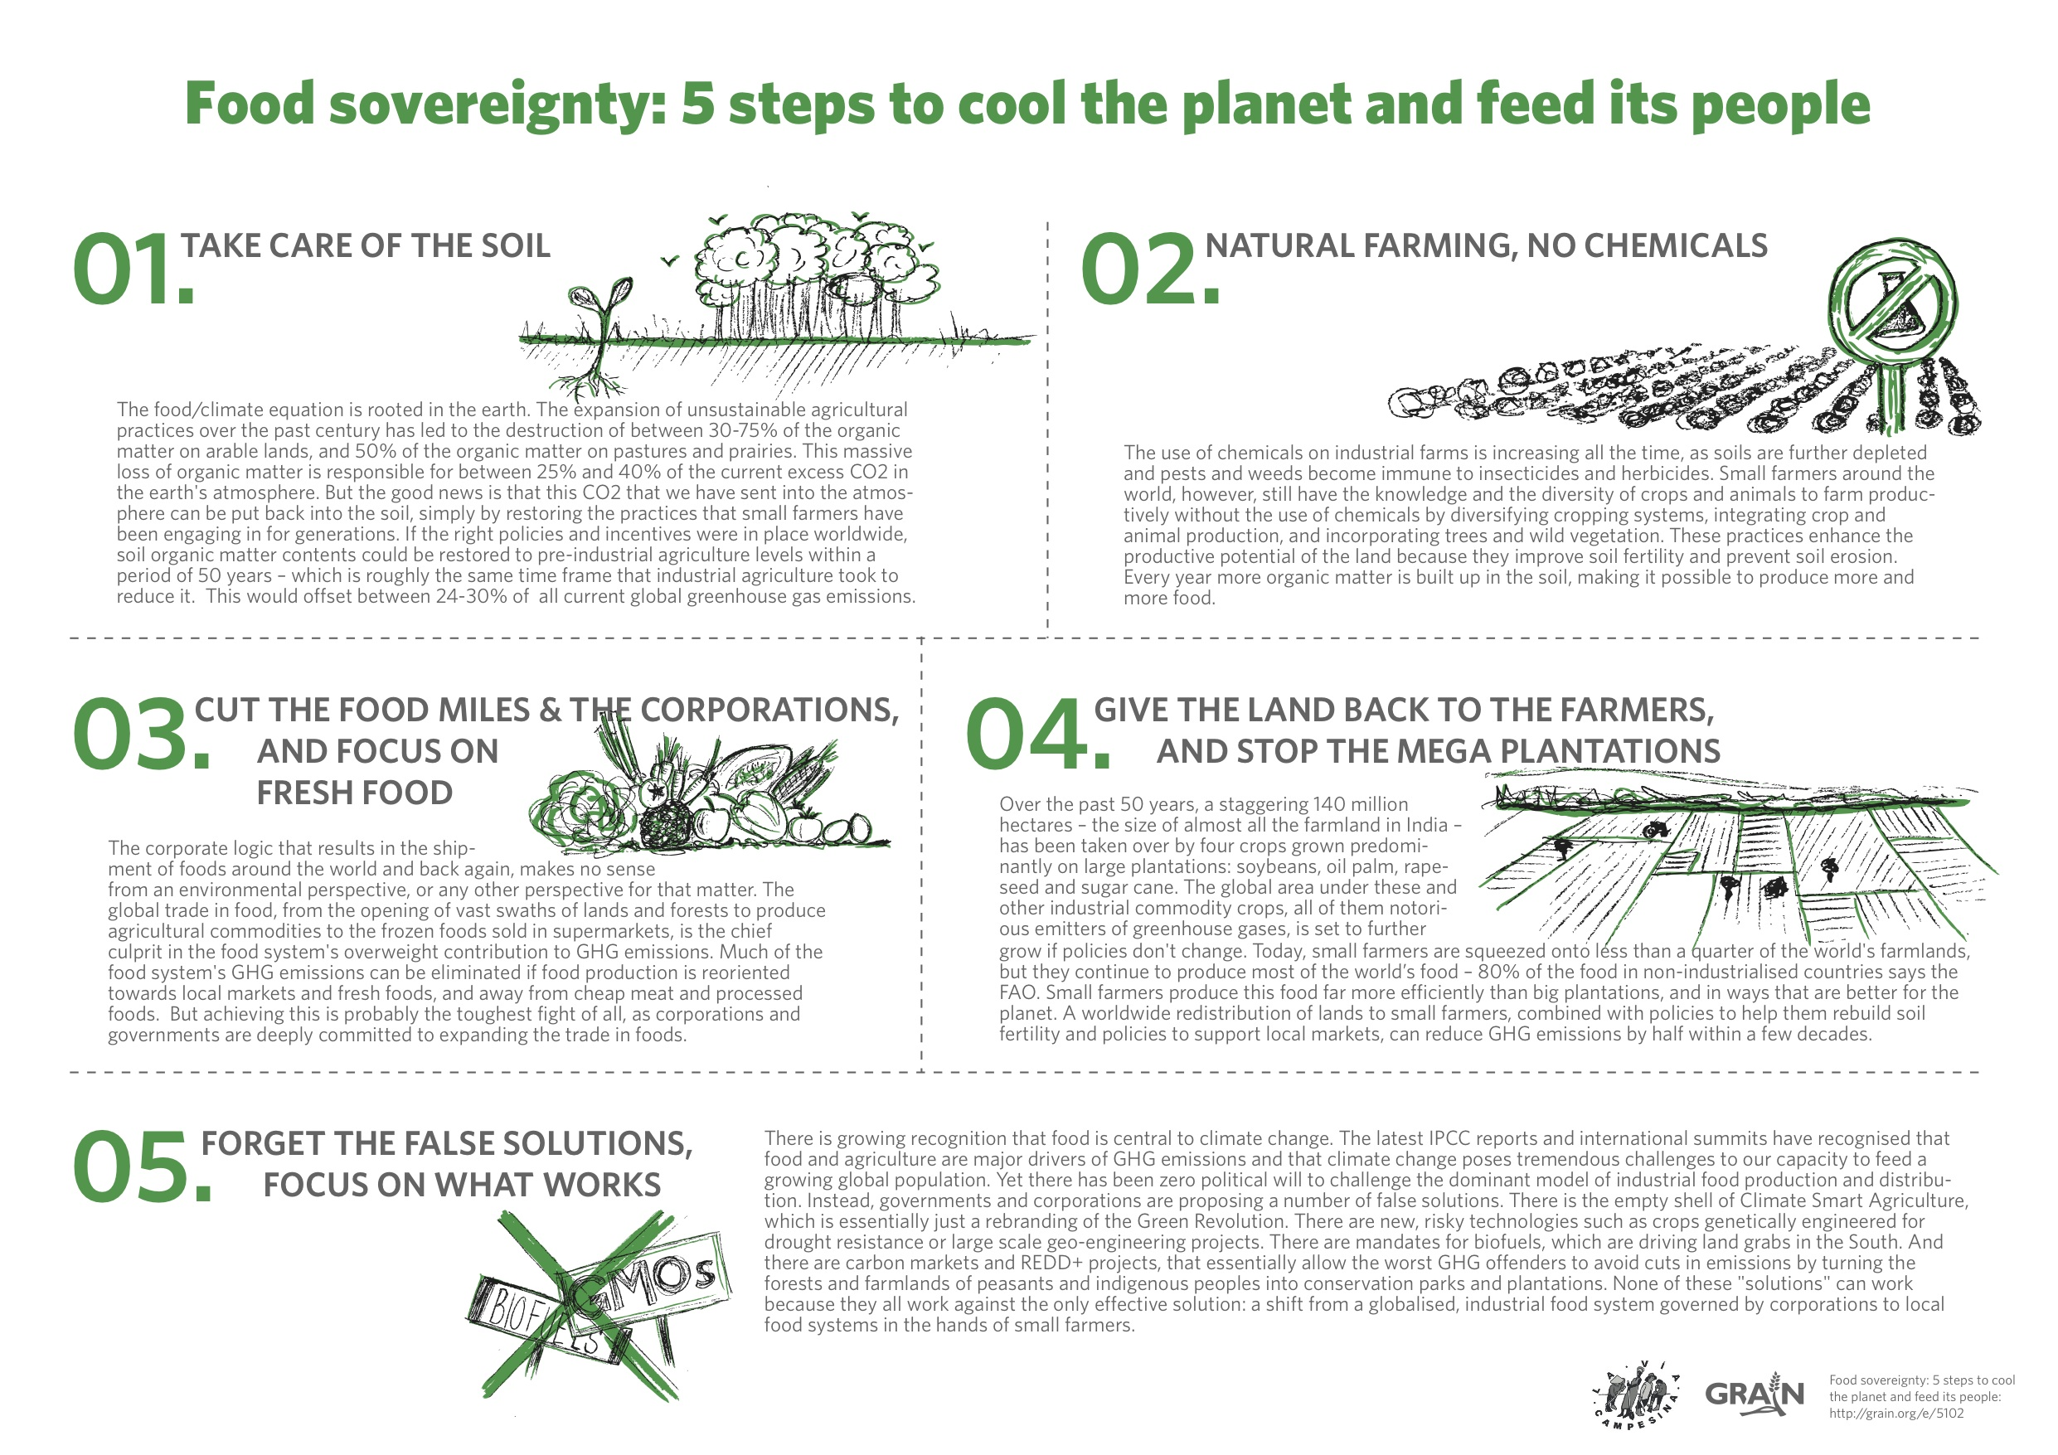

Slide 4
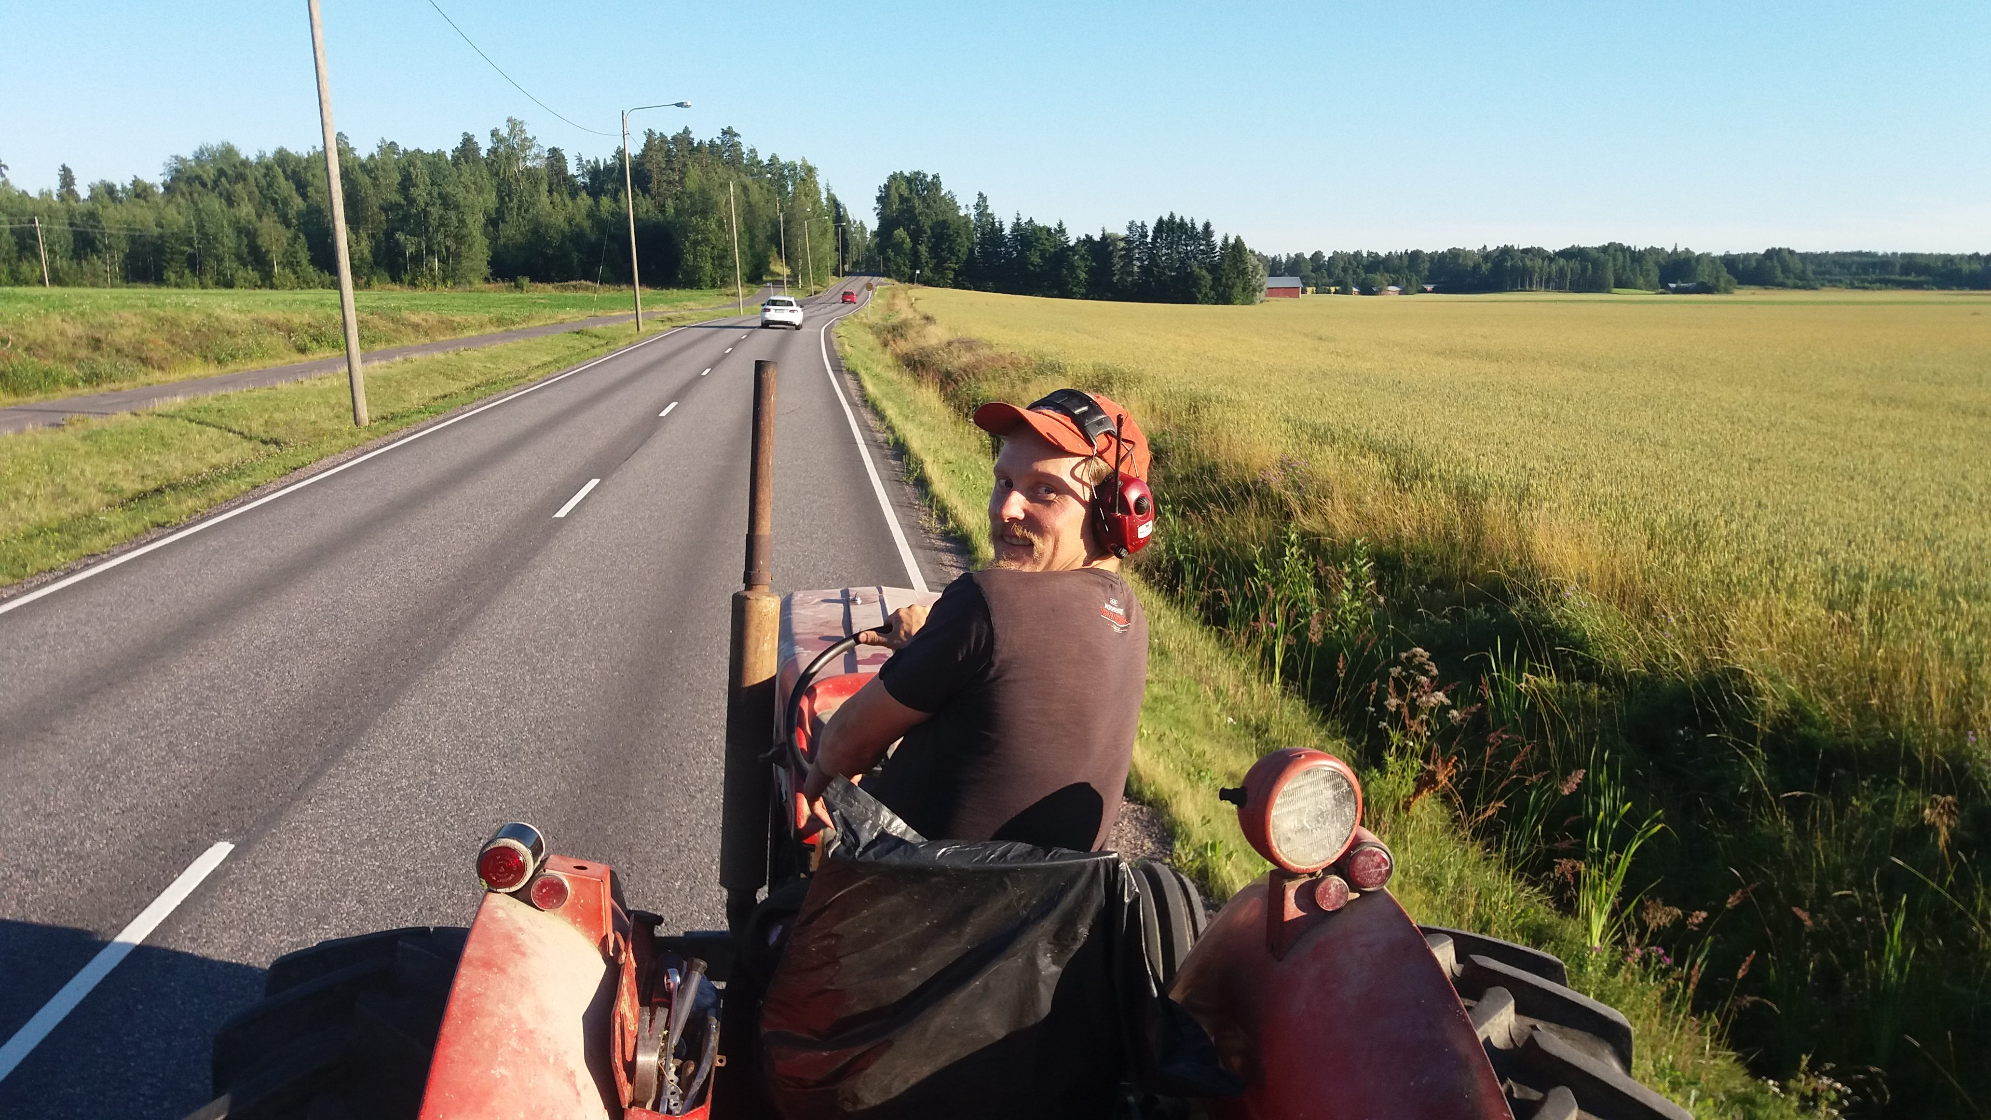
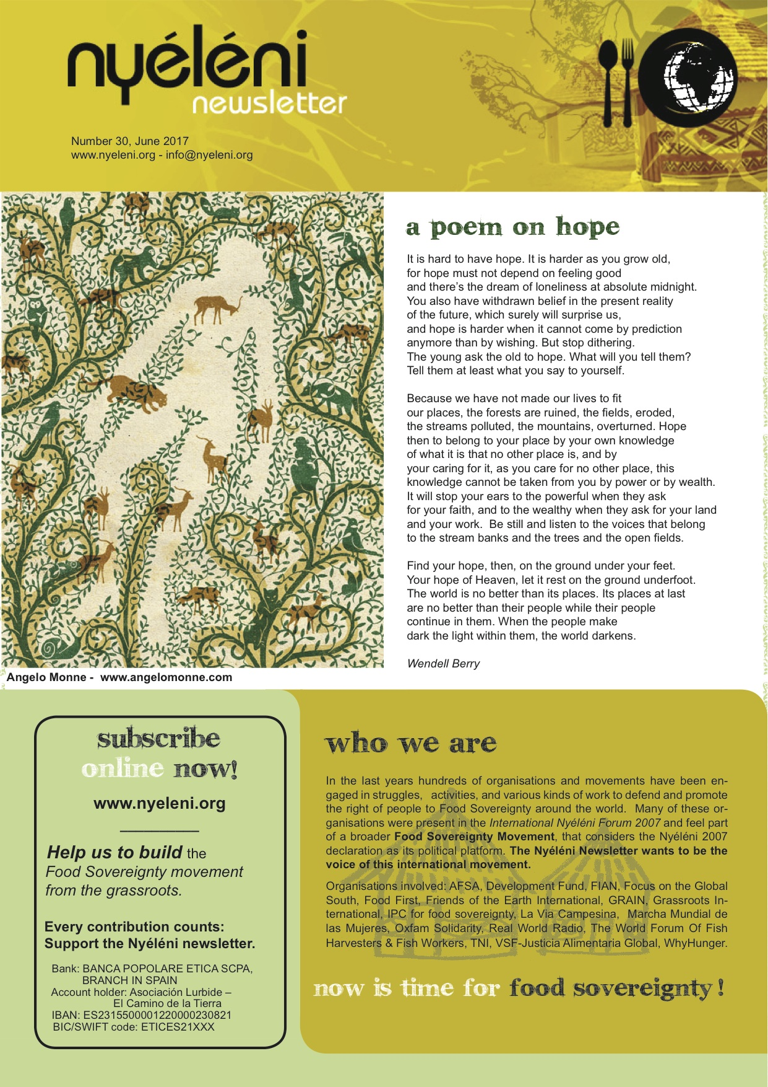

Slide 5


Slide 6
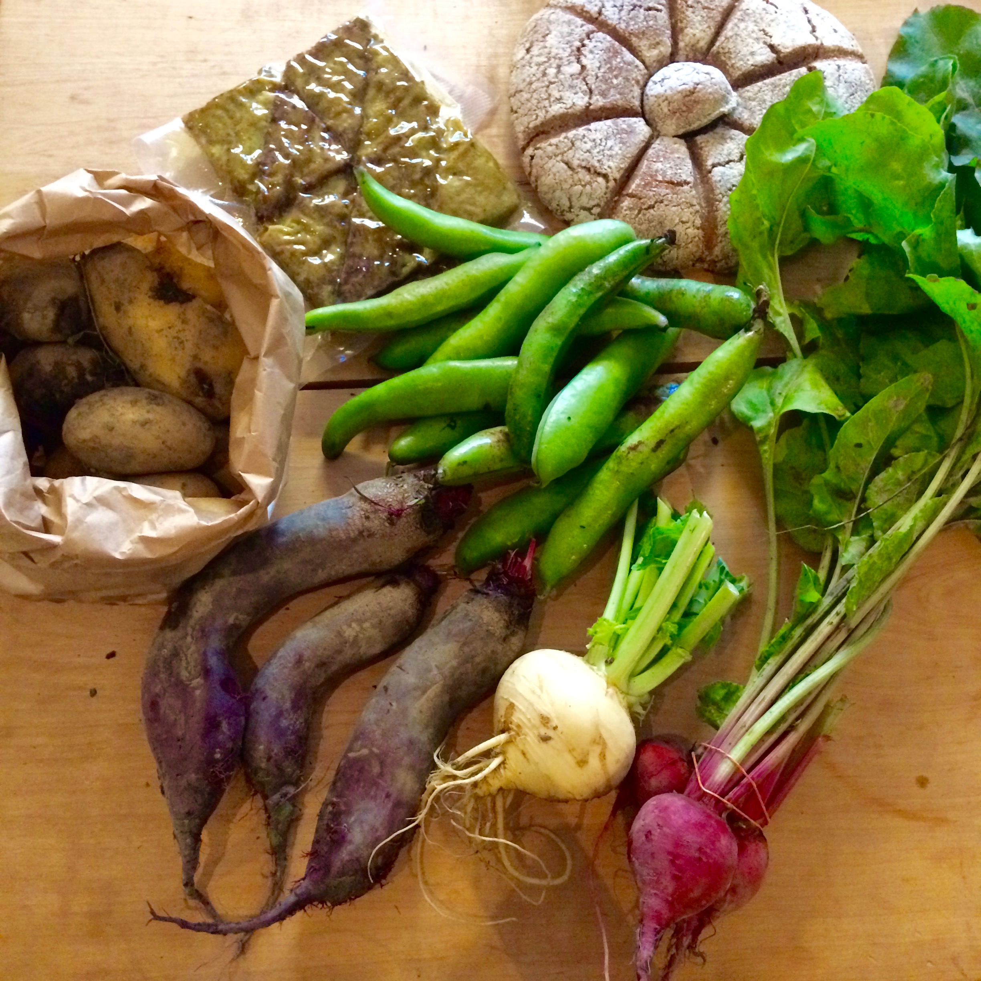

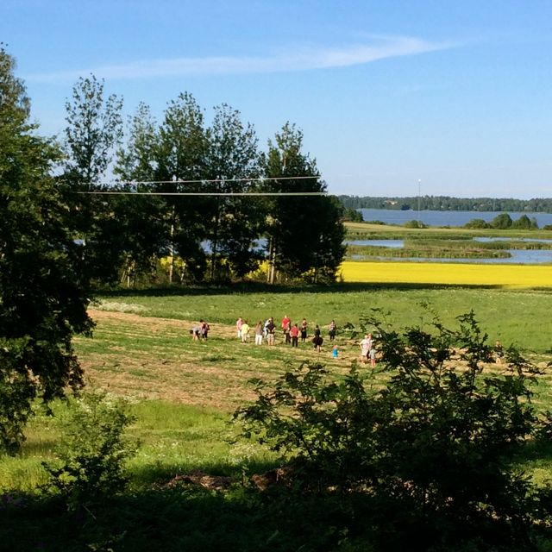

Slide 7
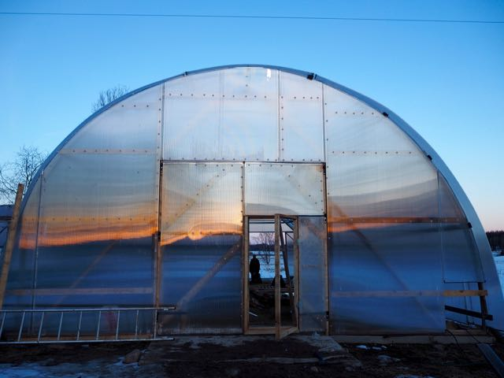
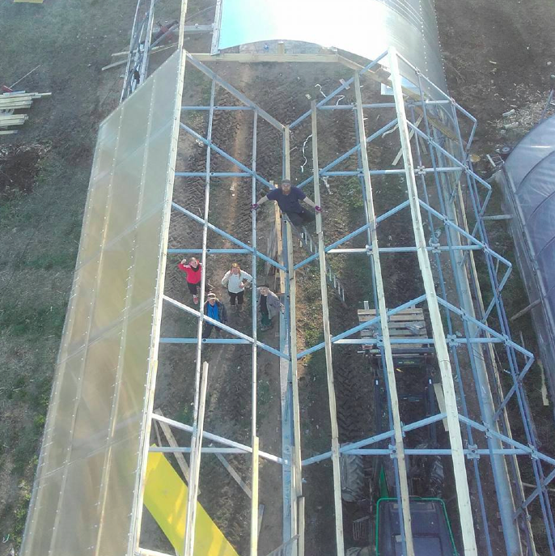
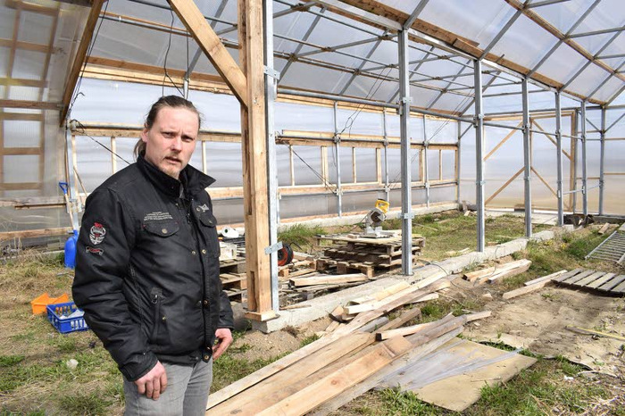

Slide 8
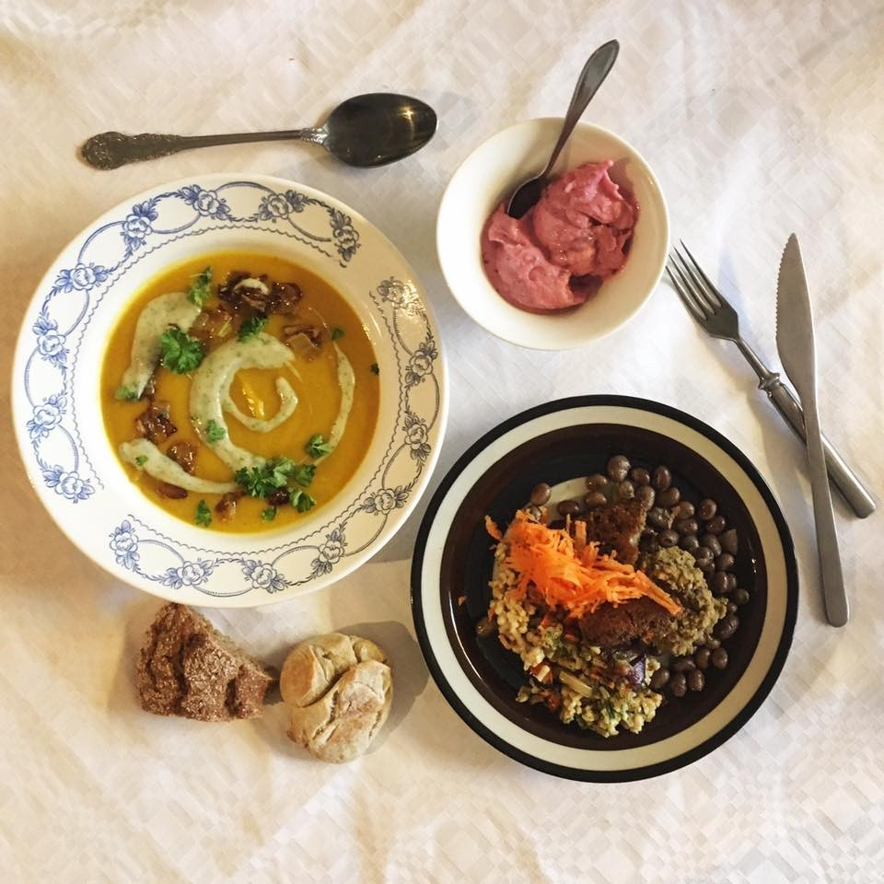
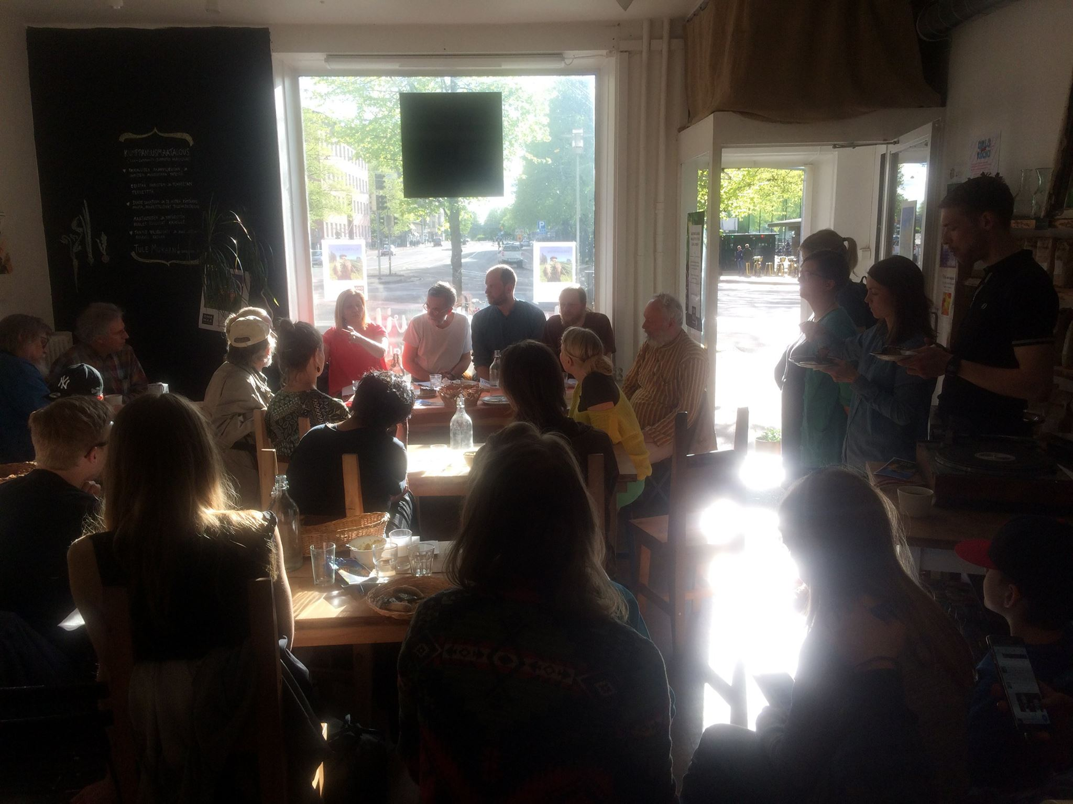
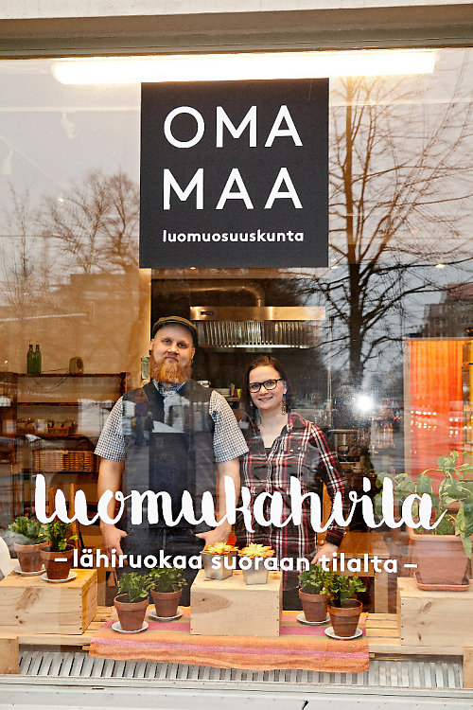

Slide 9
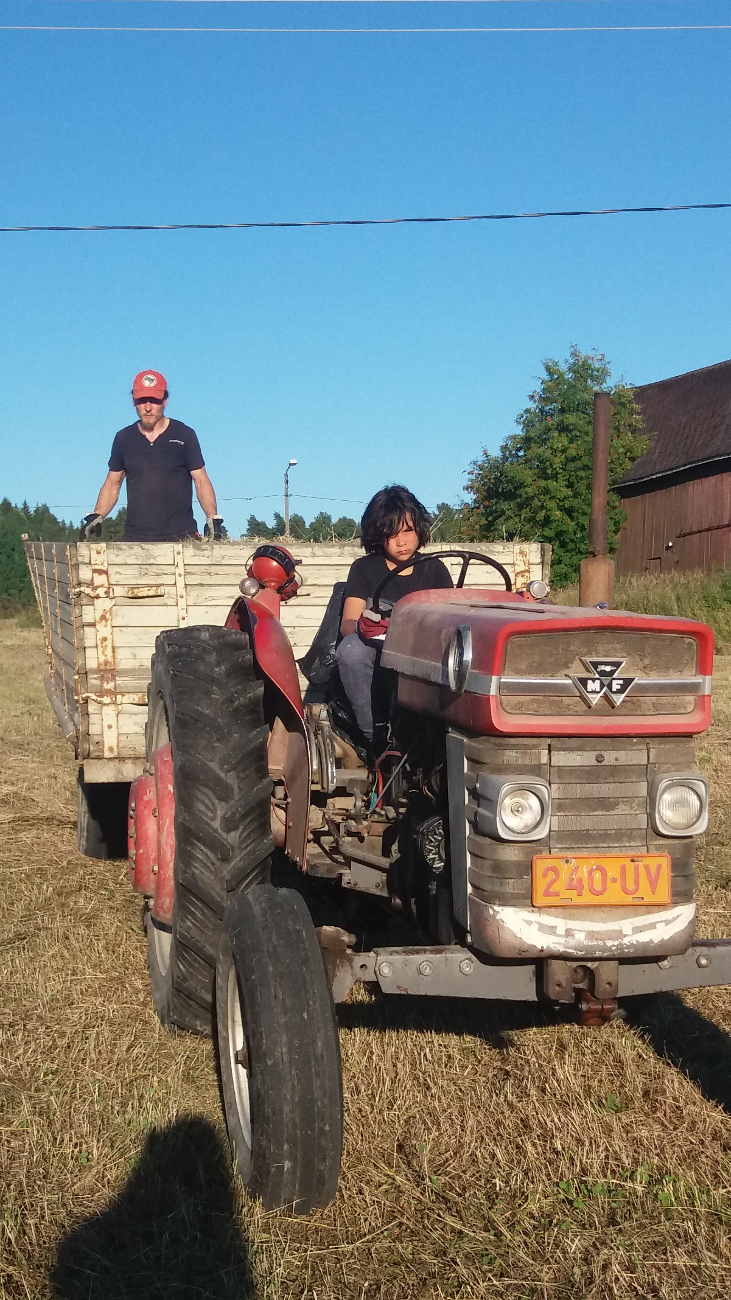
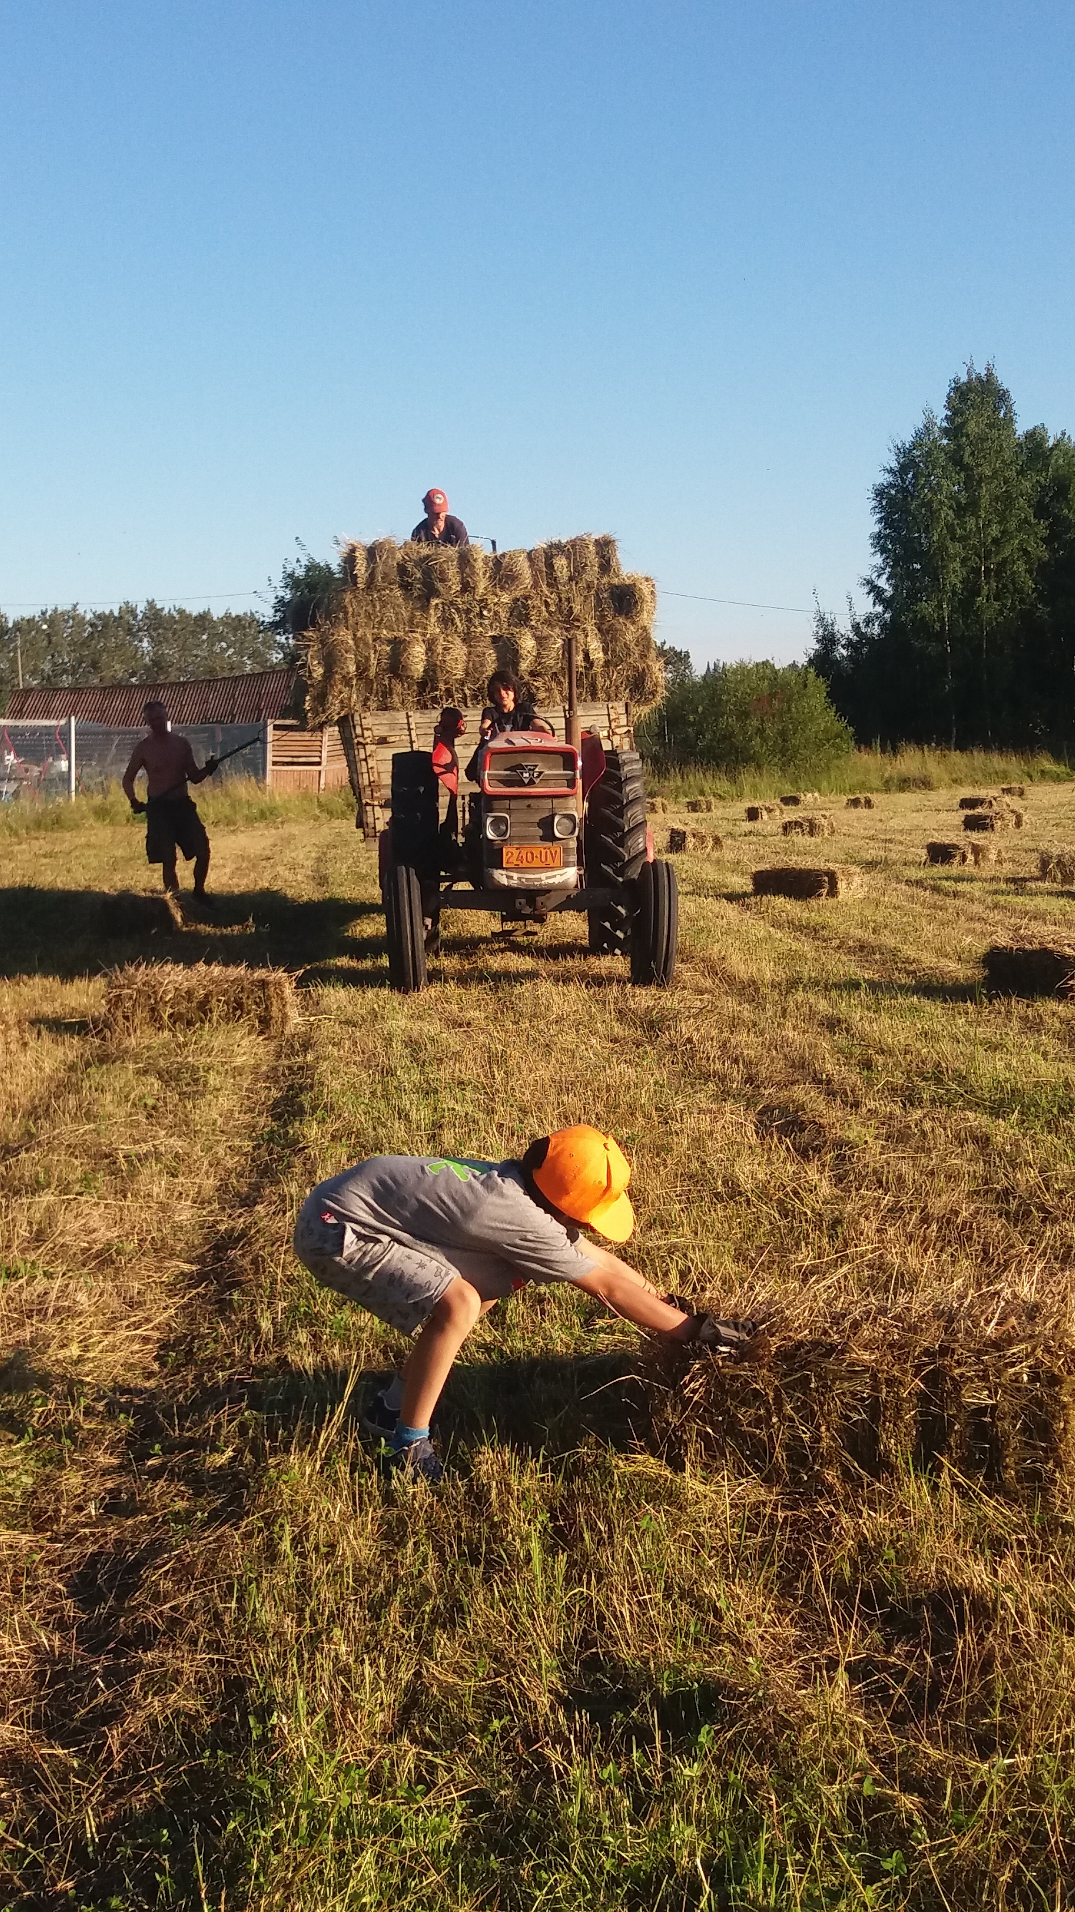
“..the primary need is not for the farm to be supported by the community, but rather for the community to support itself through farming. “ Trauger Groh, Germany
“CSA is not just
another newer and clever approach to
marketing for farmers, rather
community farming is about the
necessary renewal of agriculture
through its healthy linkage with the
human community that depends upon
farms and farmers for survival.”

Slide 10
Strengthening Solidarity Economy building and through this a furthering of our (Food) commons and the commoning around it.

Slide 11
Solidarity Economy building
Economy
Solidarity
Solidarity economy building
No blue print – but participatory discussion and mapping process, bringing economy back to being a discussion of people for people; starting point is daily life and needs.

Slide 12
Picture: Ethan Miller 2011

Slide 13



